Slide 1
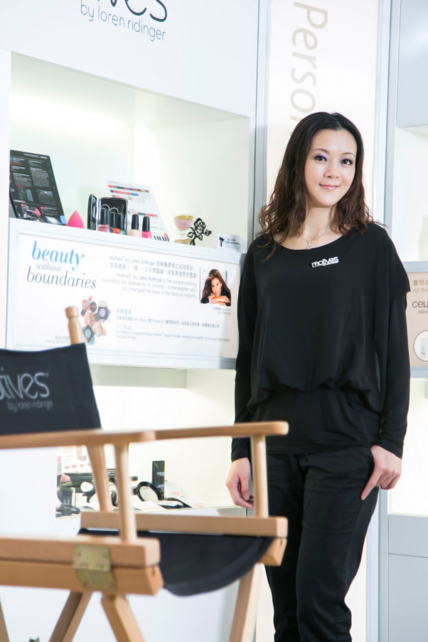
以Motives建立事業 Motives Business Opportunities
Helen Lin
總顧問經理級 National Supervising Coordinator
四個佣金週期共賺取HK$76,600*
HK$76,600 in 4 Commission weeks
*本簡報中提到的收入等級純屬舉例說明，無意代表美安香港超連鎖™店主的一般收入，也無意表示任何超連鎖™店主皆可賺取同等收入。美安香港超連鎖™店主的成功與否，取決於其在發展事業時的努力、才能與投入程度。The income levels mentioned in the following presentation are for illustration purposes only. They are not intended to represent the income of a typical Market Hong Kong UnFranchise™ Owner, nor are they intended to represent that any given Independent UnFranchise™ Owner will earn income in that amount. The success of any Market Hong Kong Independent UnFranchise™ Owner will depend upon the amount of hard work, talent, and dedication which he or she devotes to building his or her Market Hong Kong Business.

Slide 3
簡介 Profile
Motives®授証訓練員
授證訓練員
TLS®健康纖營計劃授証教練
3次Motives®挑戰賽得主
4次總裁挑戰賽得主
5次TLS®挑戰賽得主
13次UFO 超連鎖店主
2014年最高MA Cashback獎
Motives® Certified Trainer
Certified Trainer
TLS® Certified Coach
3 x Motives® Challenge Winner
4 x President Challenge Winner
5 x TLS® Challenge Winner
13 x Master UFO
2014 Winner of the MA Cashback Award

Slide 4
過程 Transformation
10多歲開始已使用零用錢購買護膚品
2007年－因健康營養產品認識美安
2010年－參與Miami Motives®訓練
2011年－正式成為Motives®授証訓練員
Used allowance to purchase skincare products at the age of 10+
2007 – Learned about MHK through health and nutrition products
2010 – Attended Motives® Training at Miami
2011 – Became Motives® Certified Trainer

Slide 5
以Motives成為主修科目
Motives as Major
什麼叫主修科：
必須要專業
自己好喜愛
How does major define?
Must be Professional
Favorable

Slide 6
為什麼選擇Motives為主修科目？ Why Select Motives as My Major?
每個人都愛美
充滿樂趣
Everyone wants to become beautiful
Fun

Slide 7
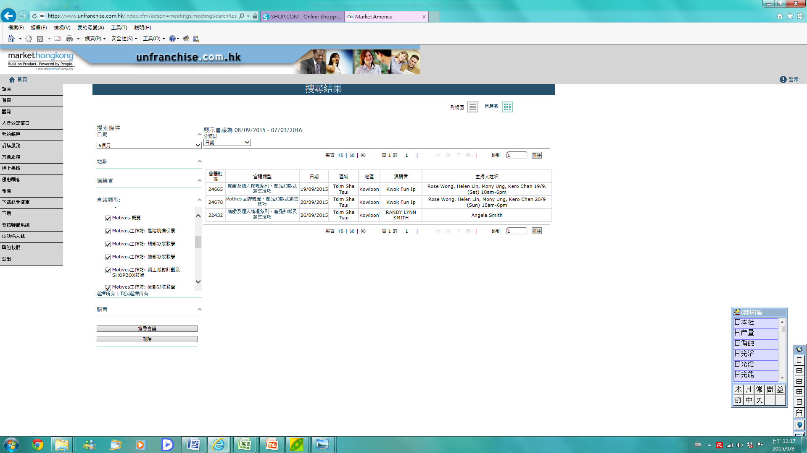

Slide 8
怎樣做？ How to do it?
1. 成為專家／專業
不斷上課
自己成為產品中的產品
1. Become professional
Attend training
Become expert in products

Slide 9
怎樣做？ How to do it?
2. 定期舉行活動（邀約）
目標：分享HK.SHOP.COM
運用公司活動， 如 Motives night／工作坊
其他產品系列
美麗由內到外
2. Host event regularly (Invite)
Goal: Share HK.SHOP.COM
Utilize mhk activities, such as Motives Night / Workshop
Other product lines
Beauty from inside out

Slide 10
怎樣做？ How to do it?
一對一介紹 One on Ones
3. 跟進
利用ABC
借力
活動接活動，帶去下一個活動
UBP/Product training/大會
超連鎖事業簡報會 UnFranchise Business Presentations
本地研討會 L o c a l S e m i n a r s
美安香港年會 Market Hong Kong Convention
領袖訓練會議 Leadership
世界大會 World Conference
國際年會
Int'l Convention
3. Follow Up
Utilize ABC patterns
Leverage
Event after event
UBP, Product Training and Event

Slide 12
2015 美安香港成功領袖會議
MHK Leadership Conference 2015

